Slide 1
Mid Day Meal Programme
Annual Work Plan & Budget [2019-20]
WEST BENGAL

Slide 2
Coverage of MDM
Category | Eligible |  | Covered |  | % of coverage
 | Schools | Enrolment | Schools | Enrolment | Schools | Enrolment
Primary | 67020 | 7263626 | 67020 | 6723230 | 100% | 92.56%
Upper Primary | 16196 | 4284300 | 16196 | 4137265 | 100% | 96.57%
NCLP | 719 | 31320 | 719 | 30717 | 100% | 98.07%
TOTAL | 83935 | 11579246 | 83935 | 10891212 | 100% | 94.06%
Proposed Number of Days for 2019-20
Primary | Upper Primary | NCLP
230 days | 230 days | 312 days

Slide 3
INFRASTRUCTURE - DETAILS
Parameter | Proposal for 2019-20 | Status upto 2018-19 | % Covered
No. of schools | 83,935 | 83690 (PAB) | 100%
No. of schools covered under MDM | 83,935 | 83690 (PAB) | 100%
No. of students covered under MDM | 1,08,91,212 | 1,07,28,942 (PAB) | 94%
No. of schools with kitchen cum store | 274 (New) + 11692 (Repair) | 77446 | 95%
No. of Kitchen Devices for replacement | 33954 | 180769 | 100%
No. of schools with Dinning Halls | 6171 | 6863 | 8%
No. of schools with Fire Extinguisher | 4205 (Urban) | 57996 | 69%
No. of Cook cum Helper engaged | 2,48,799 | 2,40,282 | 97%
No. of Education Supervisors | - | 731 | 100%
No. of schools with Kitchen Garden | 30000 | 6,407 | 8%
No. of schools with LPG | 12,502 | 71,433 | 85%
Remuneration of CCH will be proposed as Rs. 1200 (CS) and Rs. 800 (SS) along with Addl. Hon. of Rs. 500/-.
LPG installation of remaining 12502 schools will be completed during 2019-20.

Slide 4
Utilization of Fund & Food Grains
During 01.04.2018 to 31.03.2019
(Rs in Crore)
Components |  | Allocation for 2018-19 | O/B | Fund Received | Availability of fund | Fund Utilized | % of Utilization
Cooking Cost | Pry | 647.24 | 113.36 | 570.97 | 684.34 | 634.16 | 98%
 | Up. Pry | 639.36 | 112.90 | 549.03 | 661.93 | 627.92 | 98%
Transportation cost |  | 22.21 | 8.08 | 12.35 | 20.43 | 14.97 | 67%
Management Monitoring & Evaluation (MME) |  | 18.43 | 0.00 | 18.43 | 18.43 | 18.43 | 100%
Honorarium to cook cum Helpers |  | 248.80 | 41.46 | 232.02 | 273.48 | 235.17 | 95%
Cost of Food grains |  | 88.83 | 32.31 | 49.41 | 81.72 | 59.89 | 67%
TOTAL |  | 1664.87 | 308.11 | 1432.21 | 1740.33 | 1590.54 | 96%
Component |  | Allocation for 2018-19 | O/B | Lifting | Availability of food grains | Rice Consumed (In MTs) | % of Consumption
Food grains/Rice (in MT) |  | 296108.27 | 23717.97 | 199640.99 | 223358.96 | 213257.10 | 72%

Slide 5
Initiatives taken during 2018-19
Plates and glasses:- Arrangement to provide plates and glasses for taking MDM has been undertaken. State Fund of Rs. 93.66 crore has been released for purchase of Plates and glasses. Till date 10977780 units have been procured and distributed to the students.
Dining Halls:- 692 dining halls have been constructed from State Government fund in 2018-19. Further, Rs. 199.98 crore has been allotted from State Exchequer for construction of 6171 number of dining halls throughout the State, construction of which is in progress.
LPG :- An amount of Rs. 10 crore has been sanctioned from the state exchequer in the year 2018-19 for installation of 21729 number of LPG connection. Further, Rs. 27.56 crore has been allotted for procurement and installation of LPG @ Rs. 12100/- for 2 sets each school. At present 71433 institutions are using LPG for cooking MDM.
Cont..

Slide 6
Initiatives taken during 2018-19
Kitchen Garden:- In some of the school, students have been motivated to produce the vegetables by making use of available land in the school premises. This will not only make the school self-sustainable but would also inculcate the habit of self- reliance amongst the students. At present 6407 schools have developed kitchen garden. Food Processing & Horticulture Deptt. has already released Rs. 1.95 crore to 390 number of schools of Coochbehar, Malda, North 24 Parganas, Paschim Mednipur, Jhargram & Dakshin Dinajpur districts.
Fire Extinguisher:- Rs. 25.83 crore have been provided for installation of fire extinguishers to 57996 schools.
Training of Cook cum Helpers :- 39870 cook cum helpers have been trained so far. 163 Master Trainers have been trained by UNICEF. Under UTKARSH BANGLA 19025 CCHs will be trained in 2019-20.
Cont..

Slide 7
Initiatives taken during 2018-19
Fund of Rupees 35.10 crore have been provided for purchase of apron / gloves / Head Gear for cook cum helpers.
Fund of Rupees 17.55 crore have been provided for purchase of Rice containers at school level.
For cleaning and for sweeping toilets at schools Rupees 11.70 crore have been sanctioned.
Fund of Rupees 8.82 crore have been sanctioned for mobility support for DIs and SIs of schools.
Engagement of Education Supervisor:- State Government has sanctioned 731 Education Supervisors for each Educational Circle of West Bengal for better monitoring and reporting progress of Mid-Day Meal, SSA & RMSA programmes.
Cont..

Slide 8
Initiatives taken during 2018-19
Monitoring of MDM:- Committees have been created at State / District / Block / School Level. Officers of Jt. Secretary level & above are visiting different districts along with District Authorities for monitoring.
Self Declaration regarding Food Safety in Mid-day Meal: Self declaration on Food Safety has been designed and circulated among the schools for sending report on quarterly basis.
MDM App: An application has been developed for inspection of MDM. It will be available to all inspecting Officials including Education Supervisors.
Additional honorarium to cook-cum-helpers:-The State Government has allowed Rs. 500/- as additional honorarium per month per Cook cum helpers apart from state share since October, 2013.

Slide 9
Automated Monitoring System (AMS)
Started since April, 2017.
Covering around 92% schools.
SMS based reporting platform.
Schools not running MDM can be spotted instantly & follow up action to be taken.
All India Performance is among top five (5) States / UTs against all India average coverage.

Slide 10
Budget Proposal for 2019-20
Rs. In Crore
SL No | ITEMS |  | AWP&B 2018-19 |  | AWP&B 2019-20 | Remarks
 |  |  | Approved | Received including O/B | Proposed | 2018-19 | 2019-20
1 | Cooking Cost | Primary | 647.24 | 684.34 | 672.66 | Rs. 4.13 per meal | Rs. 4.35 per meal
 |  | U/ Pry. | 639.36 | 661.93 | 625.71 | Rs. 6.18 per meal | Rs. 6.51 per meal
2 | Transportation cost |  | 20.43 | 20.43 | 44.82 | Rs. 750 per MT | Rs. 1500 per MT
3 | Management Monitoring & Evaluation (MME) |  | 18.43 | 18.43 | 28.71 | 1.8 % of Central Recurring Fund | 2.7 % of Central Recurring Fund
4 | Honorarium to cook cum helpers |  | 248.80 | 273.48 | 248.80 (248799 CCH) | Rs. 1000/- per cook (10 months) | Rs. 1000/- per cook (10 months)
5 | Cost of food grains |  | 81.72 | 81.72 | 89.64 | Rs. 3000 per MT | Rs. 3000 per MT
6 | Kitchen shed |  | 7.69 | 7.69 | 7.86 (New) + 11.69 (Repair) | New: 268 | New: 274
 |  |  |  |  |  | Repair: NA | Repair: 11692
7 | Kitchen device |  | 20.44 | 0 | 55.34 | Replacement - 42171 | Replacement - 33954
8 | Flexi fund |  | NA | NA | 80.62 |  | Additional Nutrition: 65.62 Cr + Kitchen Garden:15 Cr
Total |  |  | 1684.10 | 1748.08 | 1865.85*
Central + State Share
* Central: 1185.16 Crore & State: 680.69 Crore
Only Central Share

Slide 11
PROPOSED BUDGET FOR FLEXI FUND – 2019-20
Rs. In Lakh
Proposal | Central | State | Total
A. Additional Nutrition for providing Egg / Milk @ Rs. 5/- for 55 days for 23.86 lakh children of 7 districts of Jungle Mahal, Sunderban & distressed Tea Garden Areas. | 3936.90 | 2624.60 | 6561.50
B. Development of kitchen garden of 30000 schools @ Rs. 5000/- | 900.00 | 600.00 | 1500.00
Grand Total | 4836.90 | 3224.60 | 8061.50

Slide 12
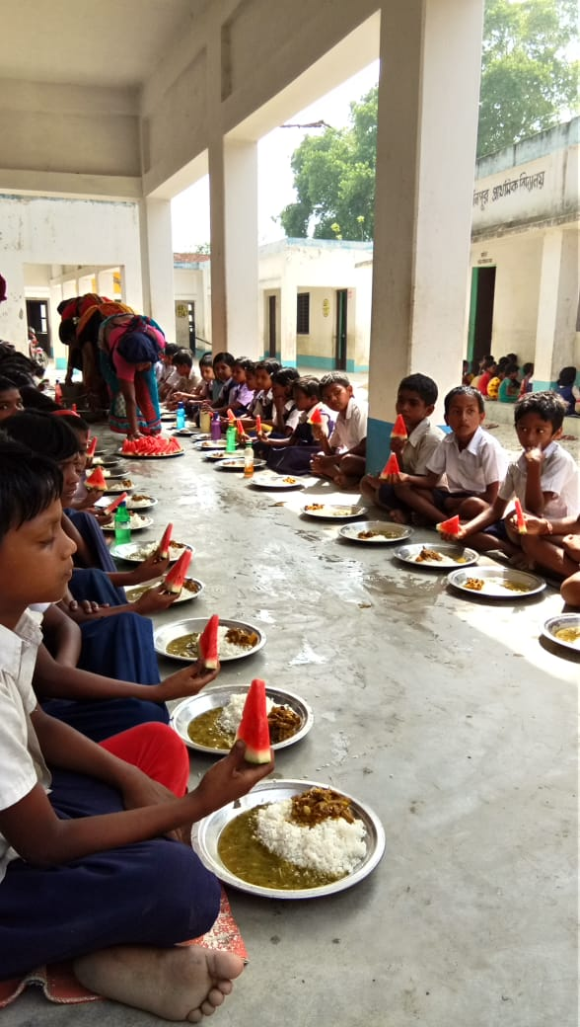
Glimpse
of
MDM

Slide 13
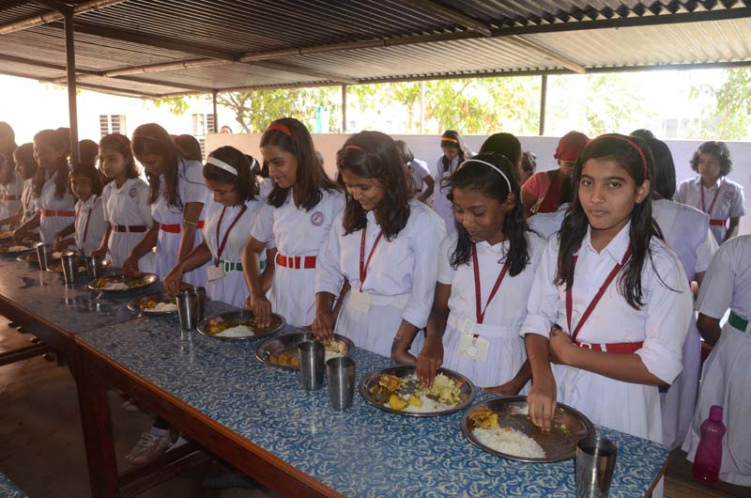
Mid Day Meal Programme

Slide 14
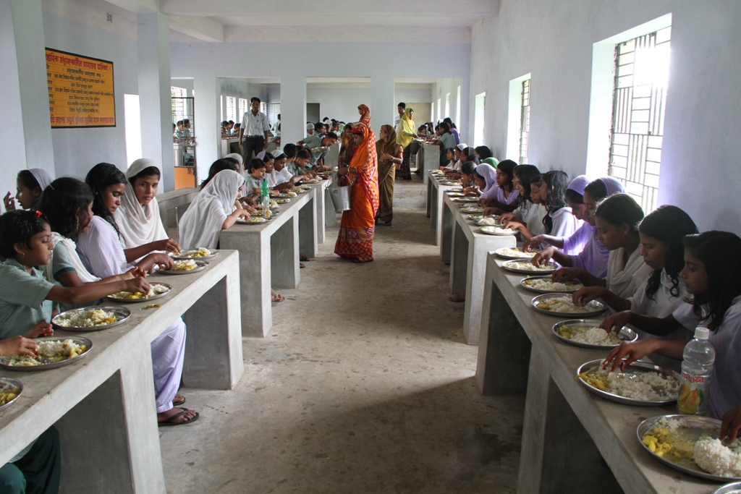
Mid Day Meal Programme
Dining at Dr Jakir Hossain High Madrasah under Tehatta-1 Block, Nadia
WEST BENGAL

Slide 15
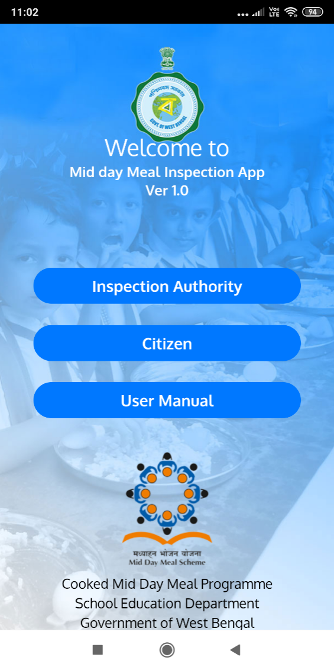
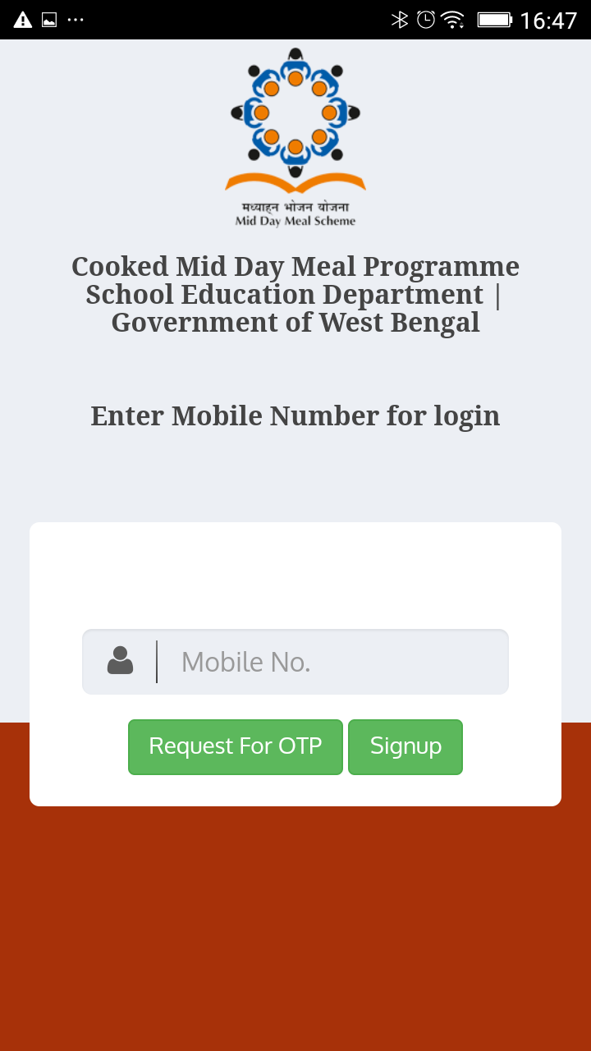
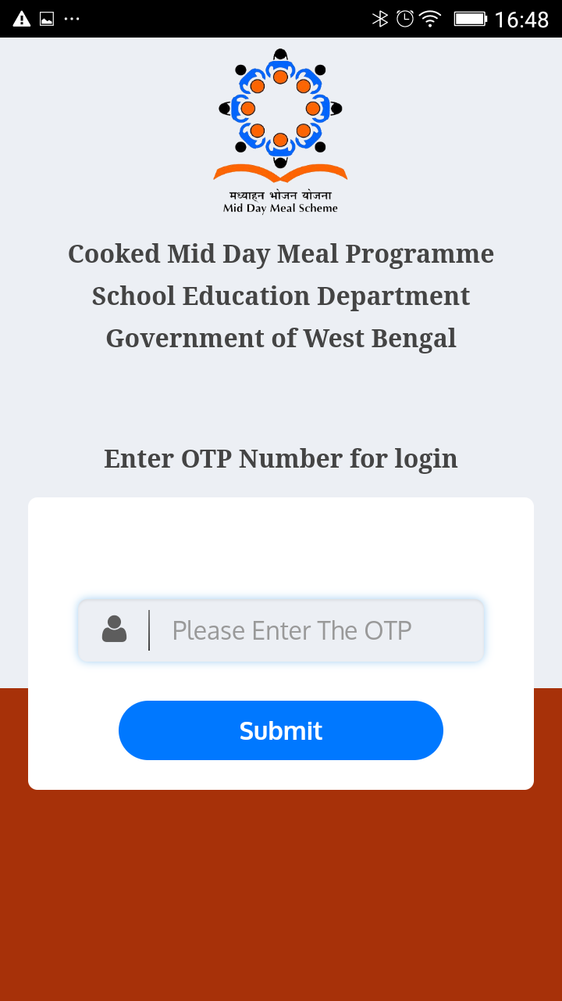
MDM INSPECTION APP

Slide 16
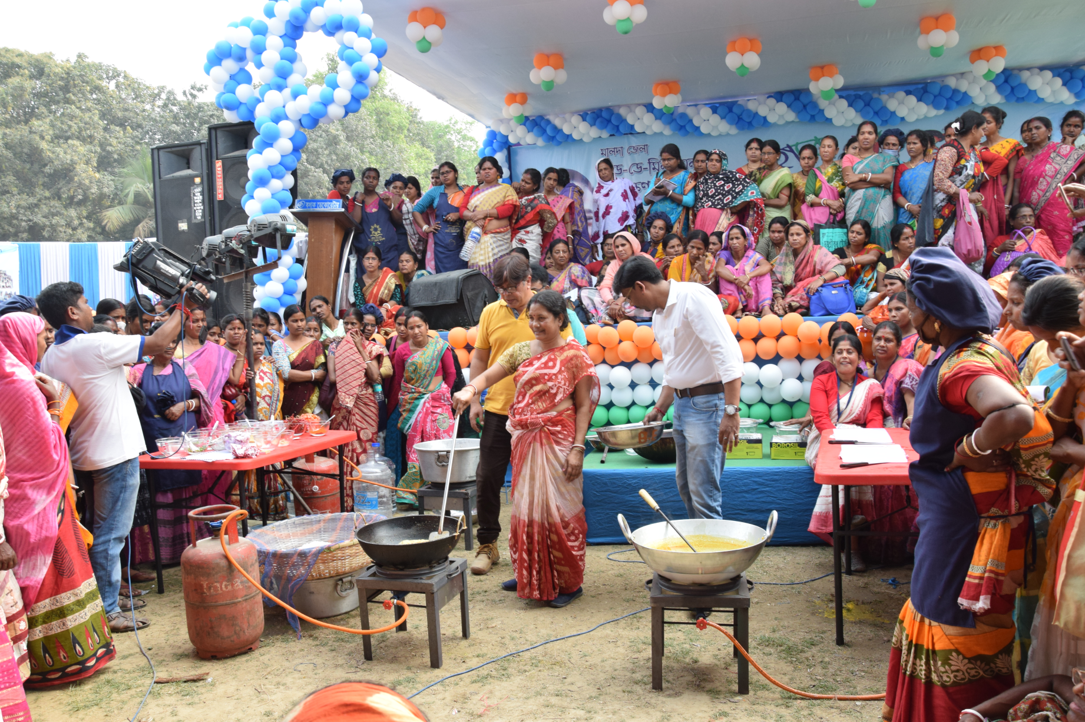
Mid Day Meal Programme
MDM MELA IN MALDA DISTRICT

Slide 17
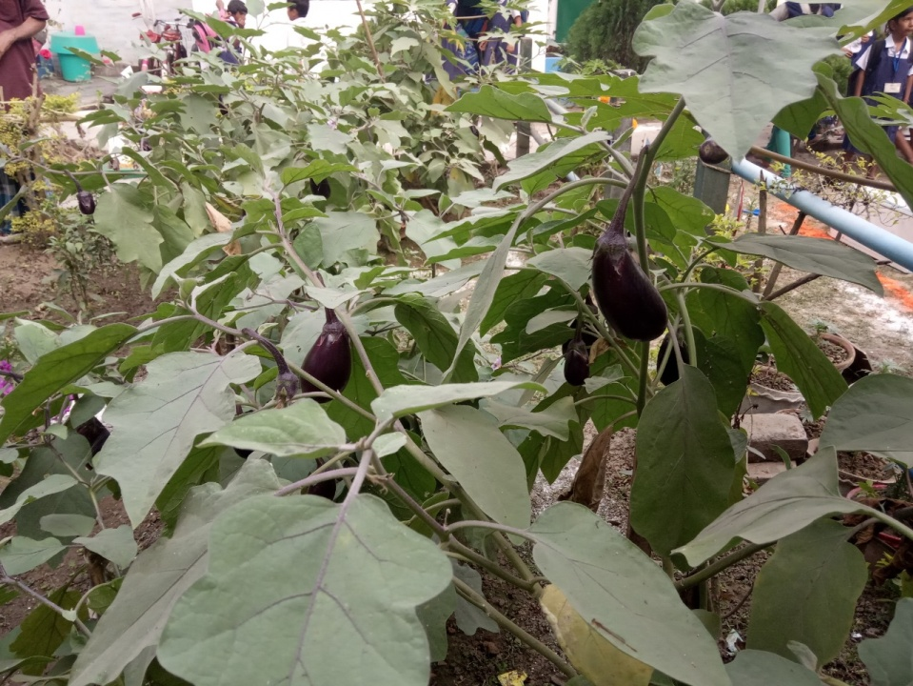
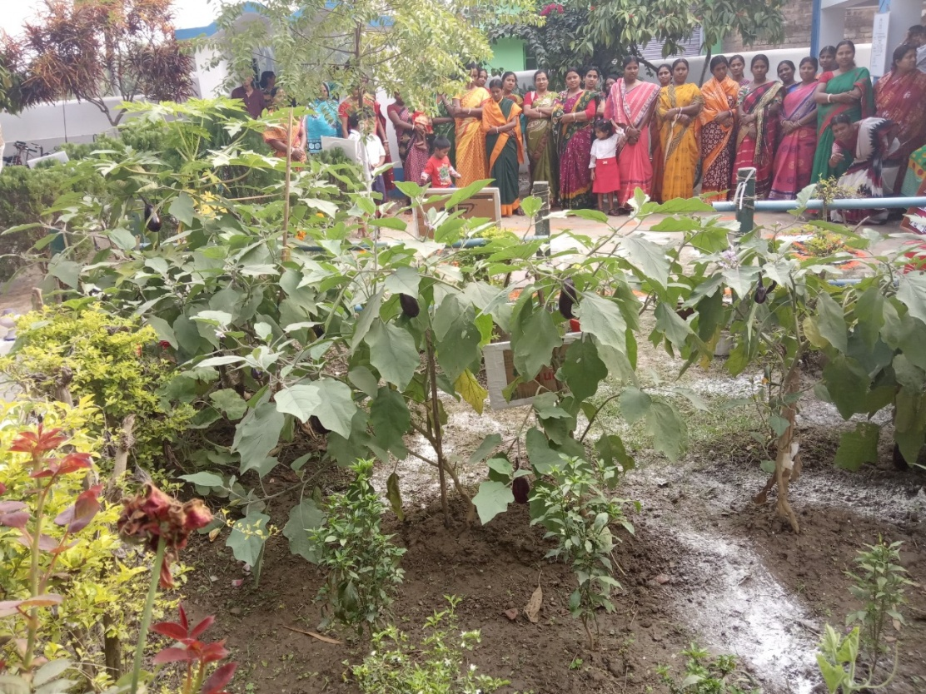
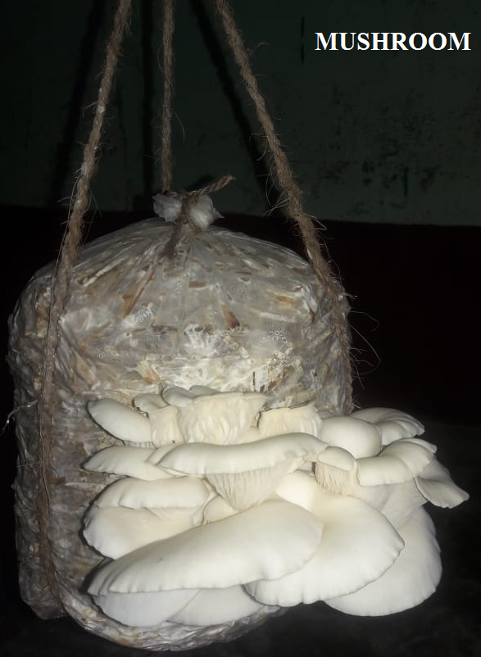
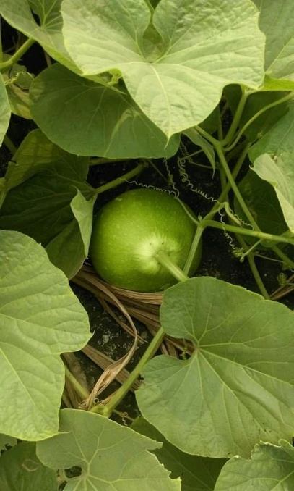
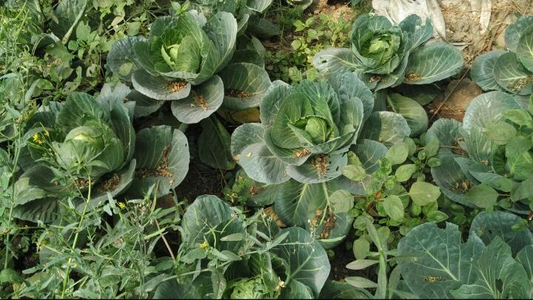
Mid Day Meal Programme
KITCHEN GARDEN

Slide 18
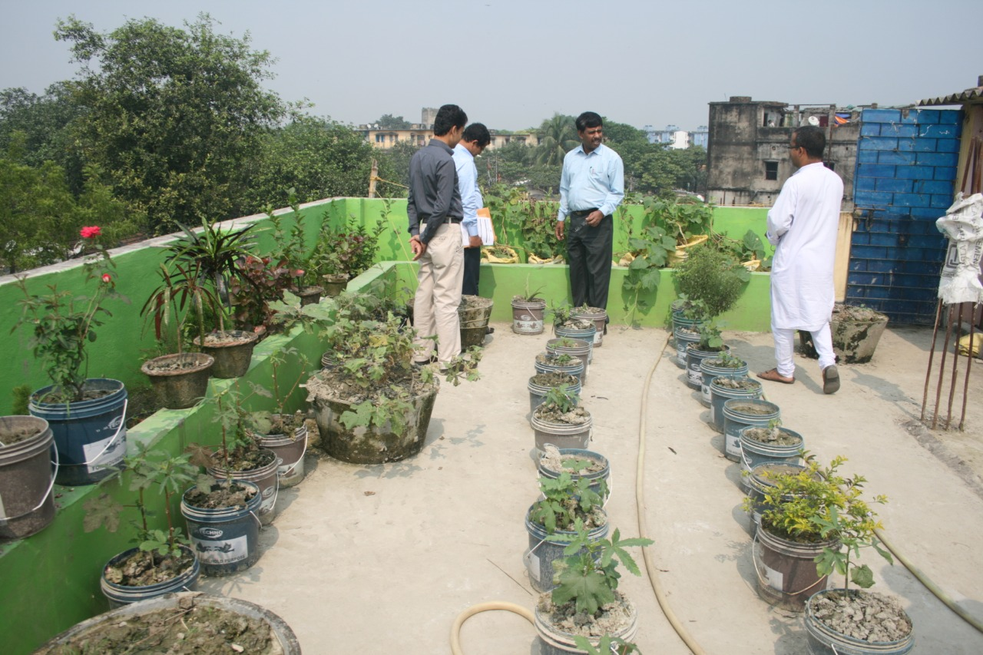
Mid Day Meal Programme
KITCHEN GARDEN
Roof top kitchen garden Boinchtala upendranath prathamik vidyalaya

Slide 19
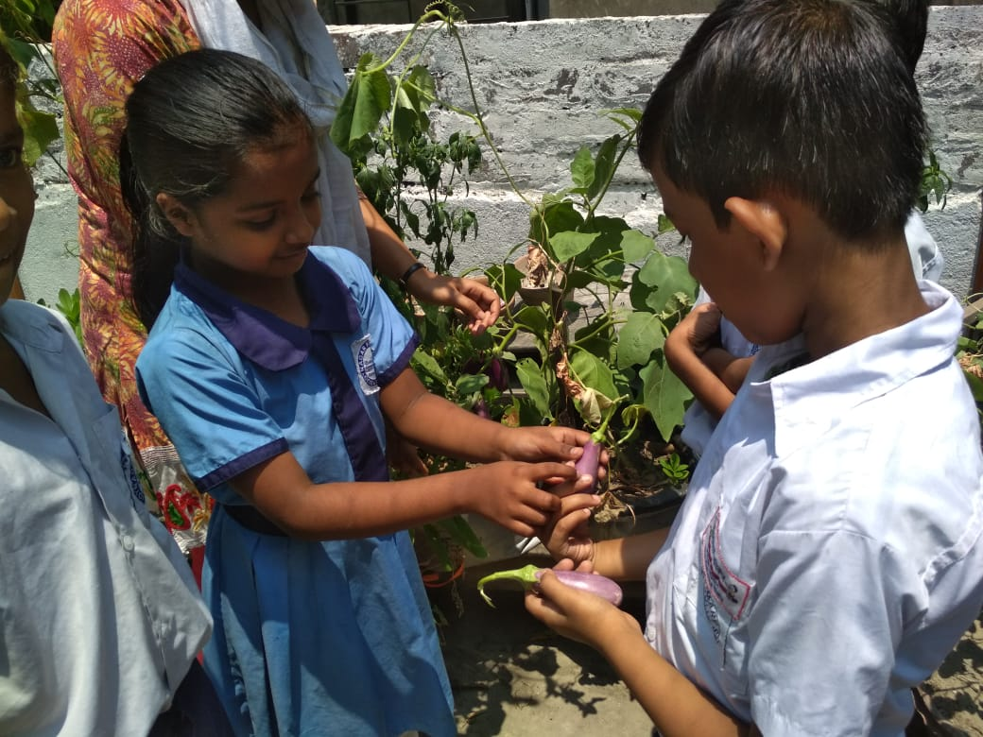
Mid Day Meal Programme
KITCHEN GARDEN
Bijoynagar GSFP school, Kolkata

Slide 20
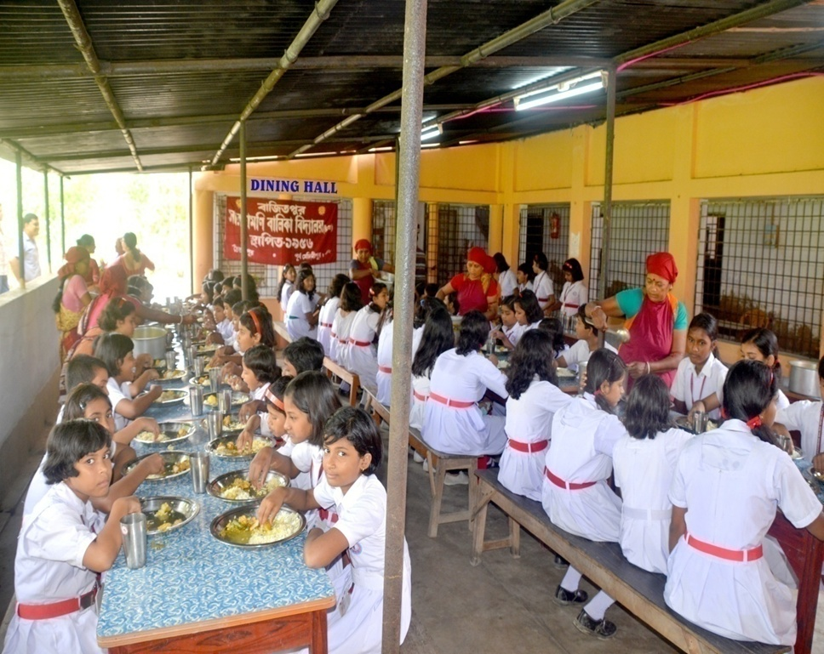
Mid Day Meal Programme
DINING HALL
Saradamoni Balika Vidyalaya, Bajitpur, Purba Medinipur

Slide 21
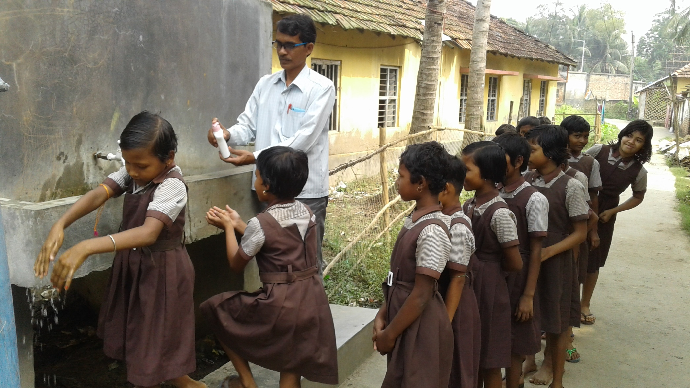
Mid Day Meal Programme
HAND WASHING
CHUNAKHALI SUHAS SMRITY PRY SCHOOL,Nandakumar Block, Purba Medinipur

Slide 22
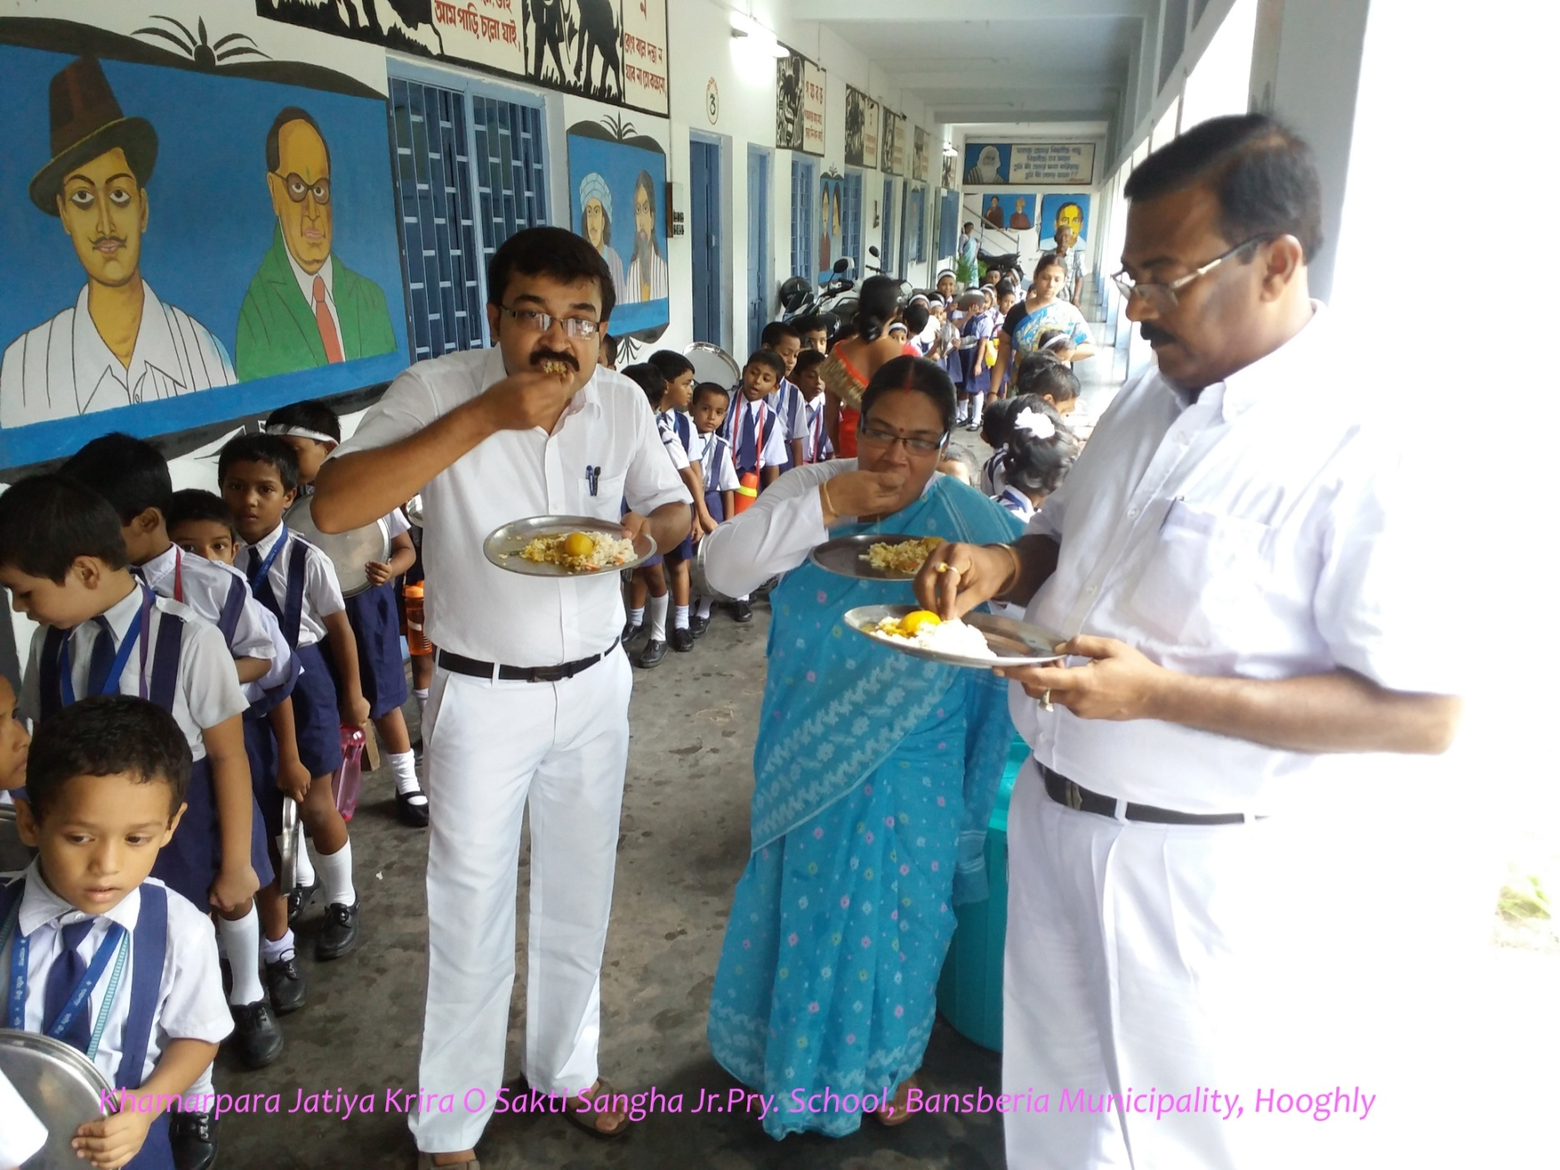
Mid Day Meal Programme
Tasting of Food Samples

Slide 23
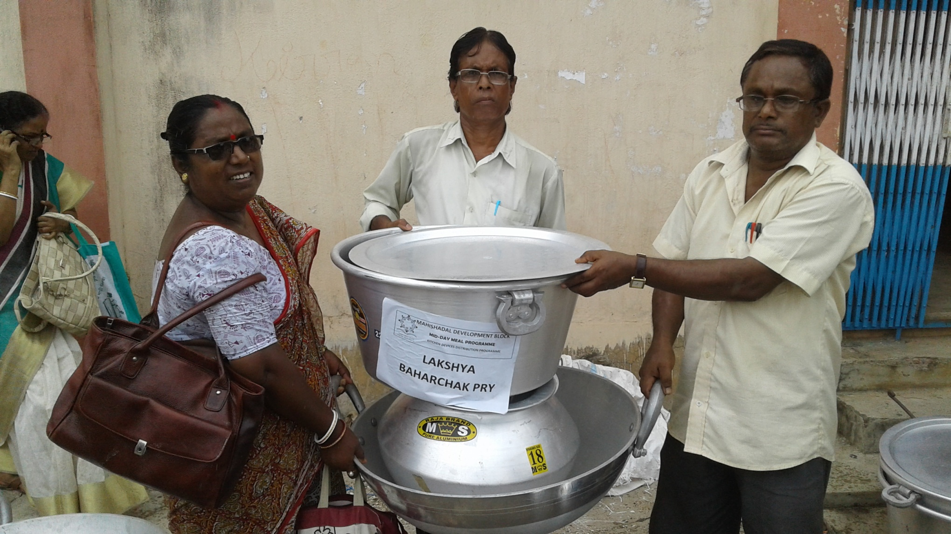
Mid Day Meal Programme
Distribution of Kitchen Device at Mahishadal Block, Purba Medinipur

Slide 24
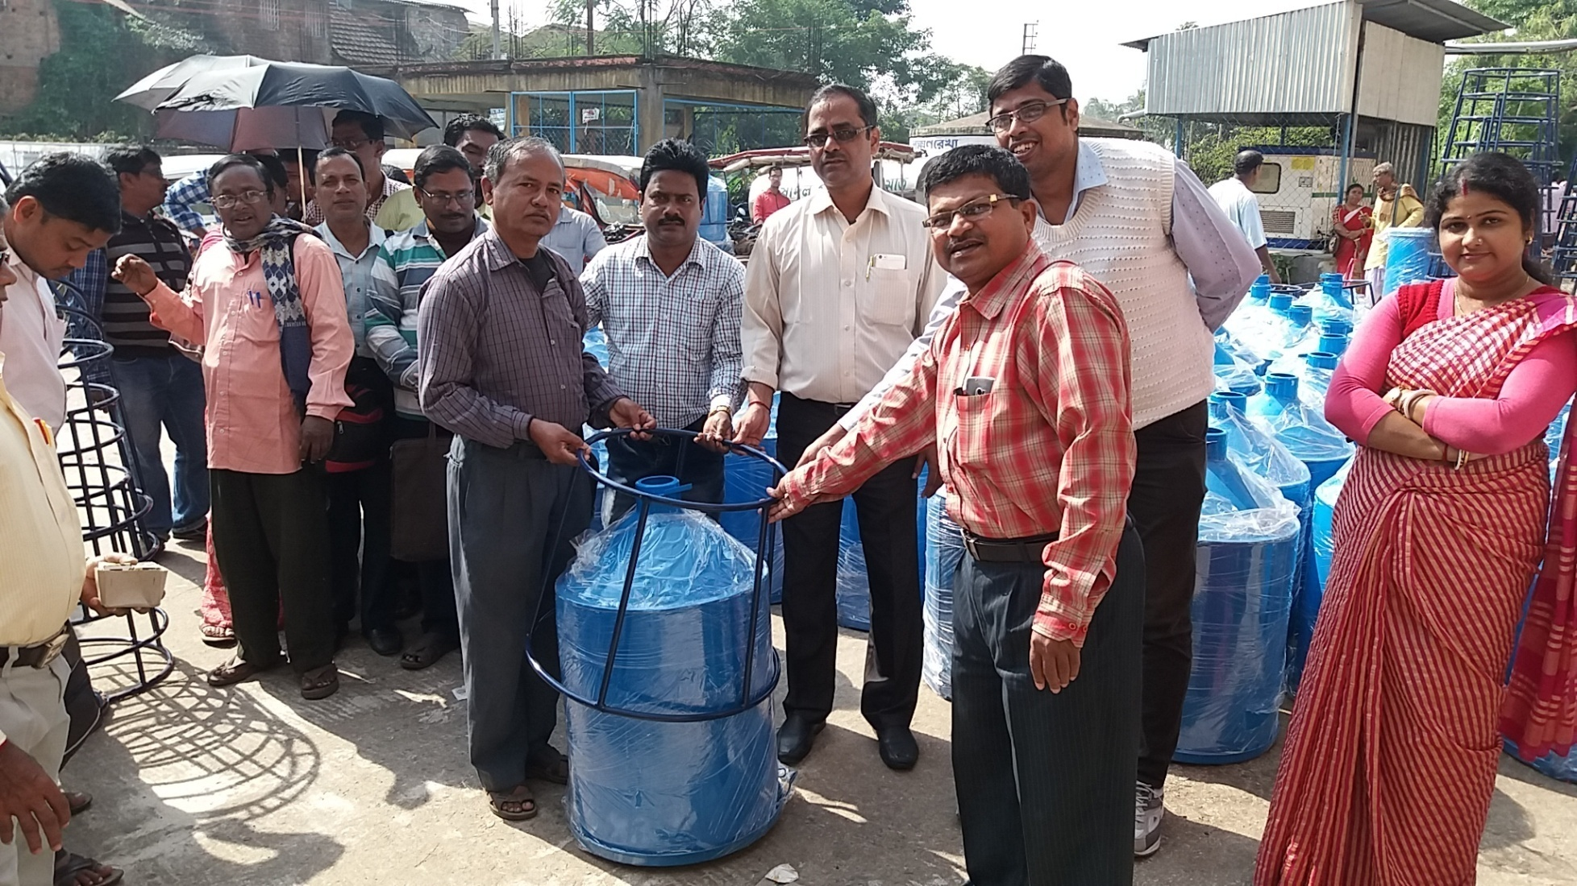
Mid Day Meal Programme
Distribution of Rice container at Mahishadal Block, Purba Medinipur

Slide 25
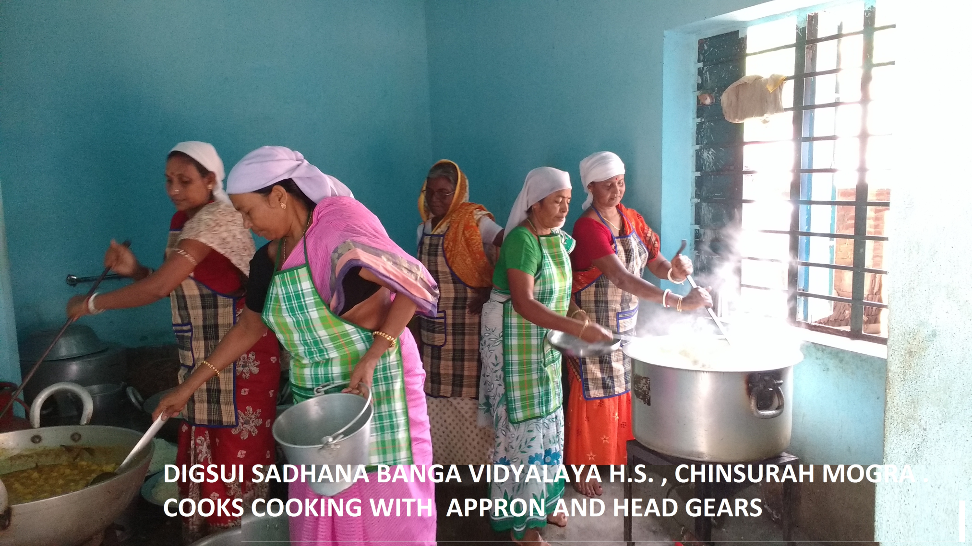
Mid Day Meal Programme
Cook cum helpers cooking with Appron and Head Gears, Hooghly

Slide 26
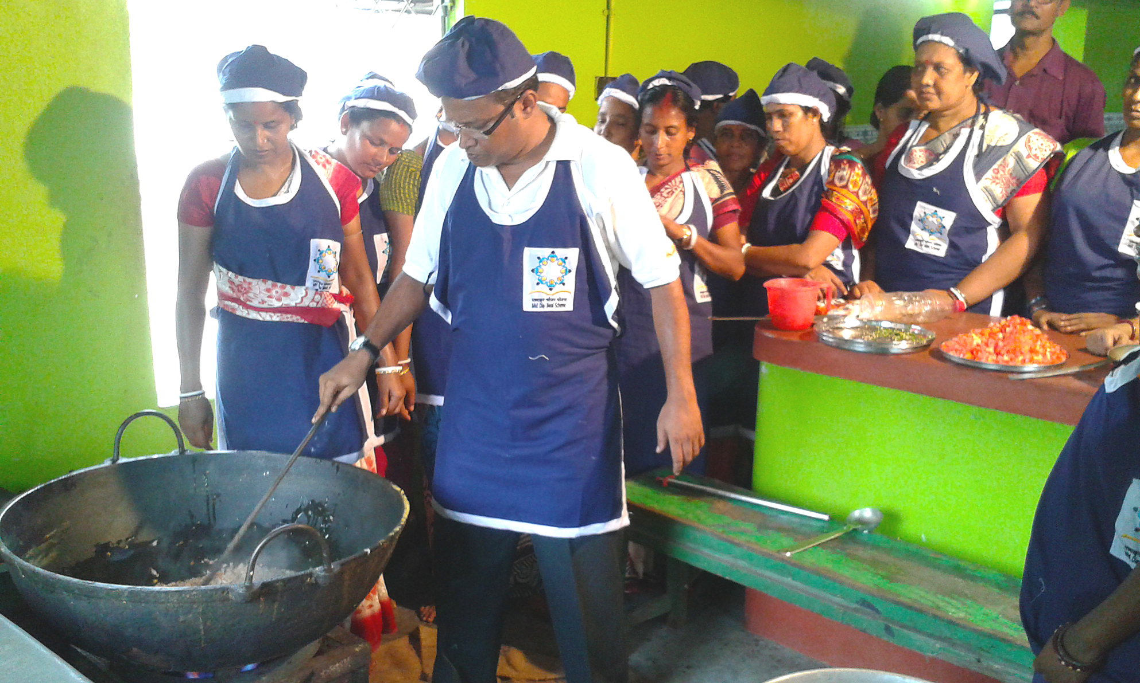
Mid Day Meal Programme
Training of Cook cum helpers by Hotel Management Institute, Hooghly

Slide 27
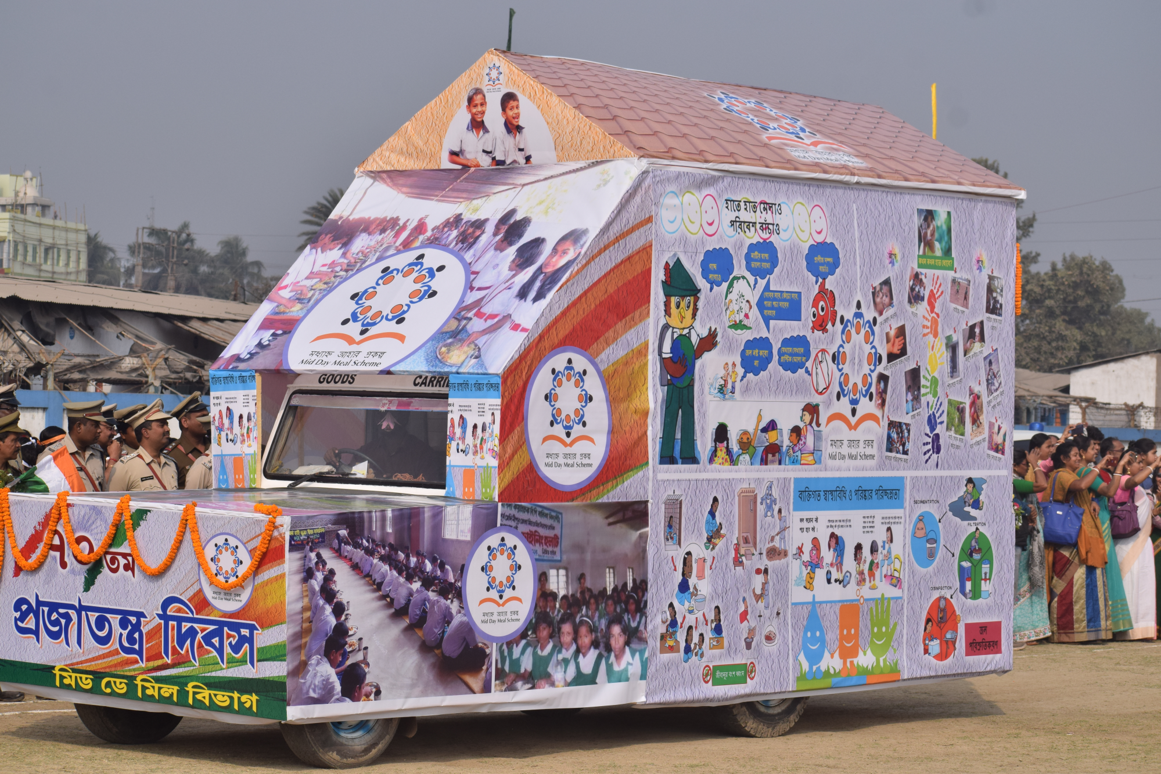
Mid Day Meal Programme
MDM Awareness Campaign on 26th January, East Medinipur

Slide 28
THANK YOU
Govt. of West Bengal
School Education Department
Mid Day Meal Section

